Slide 1

Project Response Team
By: Mackenzie Falla and Elizaveta Sorokina

Slide 2

Description of our Project: By: Mackenzie
The Project Response Team is dedicated to helping first responders reach victims more quickly and efficiently. Our comprehensive database includes vital information such as the names of victims, incident types, emergency contacts, locations, and timestamps, among other crucial details. Our goal is to enhance the safety and effectiveness of first responders while ensuring the protection and well-being of our communities.

Slide 3

Its Functionalities: By: Mackenzie
We have developed features including profile creation, emergency contact setup, and incident report submission. Our database can determine the nearest response team based on location, ensuring a swift and efficient response. In case of an emergency, the system will notify your emergency contact and provide their address if needed. All information is securely maintained on a need-to-know basis to ensure user safety and confidentiality.

Slide 4
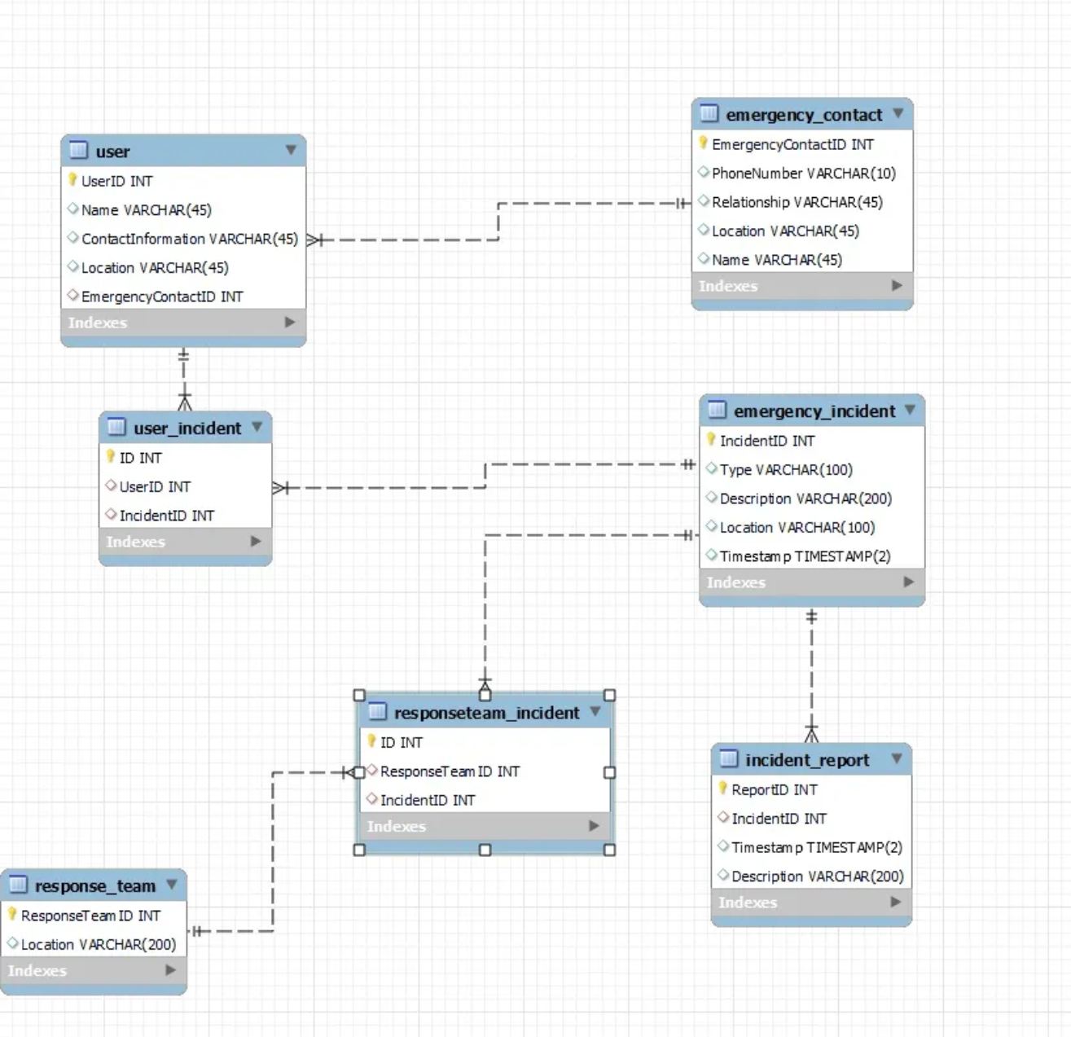
Entity-Relationship Diagram By: Elizaveta
The relationship between Users and Emergency Contacts, as well as between Users, is one-to-one. This means a single user can have only one emergency contact and but a single user can be associated with multiple incidents. Therefore, user to user incident is a one-to-many.
Similarly, Emergency Incidents have a one-to-many relationship with both User Incidents and Response Team Incidents. This indicates that a single emergency incident can involve multiple users and multiple response teams.
Additionally, there can be multiple incident reports for a single emergency incident, reflecting the detailed documentation of each occurrence.

Slide 5
Demonstrate Database Functions By:Elizaveta
Query to enter:
Select all users and their emergency contact:
SELECT u.UserID, u.Name AS UserName, ec.Name AS ContactName, ec.PhoneNumber, ec.Relationship
FROM user u
LEFT JOIN emergency_contact ec ON u.EmergencyContactID = ec.EmergencyContactID;

